Slide 1

HOSPITAL MANAGEMENT SYSTEM
Under The Guidelines Of
Dr. Enas Elgeldawi
Eng. Rehab galal
Submitted to:

Slide 2
Team’s Name
01
02
03
Hadeer
Merna
Demiana
04
05
06
Mariam
Rana
Ahmed
Mahmoud shaban 21-02137
Saeed Habib 21-02108
Aiad Eshak 21-01896
Medhat Naeem 21-02083
Ragab hassan
21-01904
Mohamed Ahmed 21-01841
07
08
Mohamed
Mahmoud
Sayed Gomaa 21-02041
Essam Abdel Star 21-02066

Slide 3
TABLE OF CONTENTS
Introduction
Related work
01
02
System Requirements
System design
03
04
Problem statement , Aim & objects
Existing System & Overall Solution Approach
Frontend & Backend and machine learning.
UML Diagrams , ERD, GUI & Machine algorithms

Slide 4
01
Introduction
About our Hospital Management System Website

Slide 5
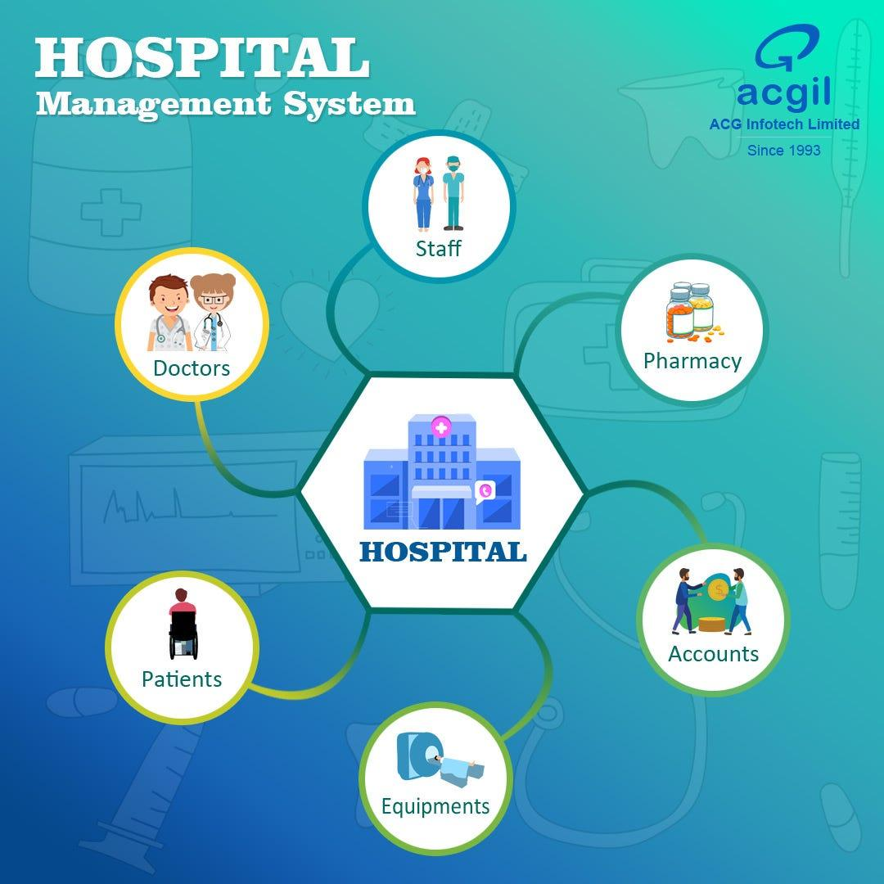
INTRODUCTION
Streamlines and organizes hospital processes and activities
Patient management
Medical record keeping
Doctor scheduling
Administration of human resources
Financial management
The project revolves around two diseases
Brain tumor and skin cancer.
Aims to provide an efficient and secure environment
Enhances healthcare delivery
Ensures timely access to critical information and data

Slide 6
Aims & Objectives
Project Aim:
The primary aim of the Hospital Management System (HMS) project is to develop a comprehensive, user-friendly, and efficient system that automates and streamlines the administrative and clinical operations of a hospital. This system is intended to enhance the quality of patient care, improve operational efficiency, and ensure accurate and secure management of patient information.
Objectives:
1) Define Hospital Operation
2) Patient Information Management
3) Billing Automation
4) Diagnosis Recording
5) Deep Learning for Medical Imaging
6) Resource Optimization
7) Enhanced Patient Experience
8) Compliance and Reporting
9) Scalability and Flexibility
10) Support Decision-Making

Slide 7
02
Related work

Slide 8
Related Work : Hypercare
Related work
In the realm of healthcare management, several existing systems have been developed to address the complexities of hospital operations.
These systems vary in scope and functionality, but they all aim to enhance the efficiency and effectiveness of healthcare delivery.
Understanding these existing systems provides valuable insights into the features, benefits, and limitations that can inform the development of a new Hospital Management System (HMS).

Slide 9
Existing System
The current manual system involves extensive paperwork.
Maintaining sales and service records is time-consuming.
As the database grows, managing and organizing information becomes difficult.
Large quantities of file cabinets are required, taking up valuable office space.
Retrieving records of previously registered patients is a tedious process.
The lack of security leaves the system vulnerable to disorganization or tampering.
The manual system does not provide easy access to essential details about available doctors.
The receptionist and operational staff handle all tasks manually, involving significant paper handling.
Doctors are burdened with remembering various medicines for diagnosis, which may lead to missed opportunities for better alternatives.

Slide 10
Overall Problems with Existing system
overall solution
approach
Inefficiency in Administrative Processes
Inaccurate and Fragmented Data Coordination
Resource Management Challenges:
Long Wait Times and Poor Patient Experience
Security and Privacy Concerns
Compliance with Healthcare Regulations
Dependence on Outdated Systems
High Initial Costs and Implementation Time
User Adoption and Training
System Integration and Automation
Centralized Data Management
Enhanced Communication and Coordination
Resource Optimization
Improved Patient Experience
Machine Learning and Deep Learning Integration
Robust Security and Privacy Measures
Compliance and Reporting
Scalability and Flexibility
User Training and Support

Slide 11
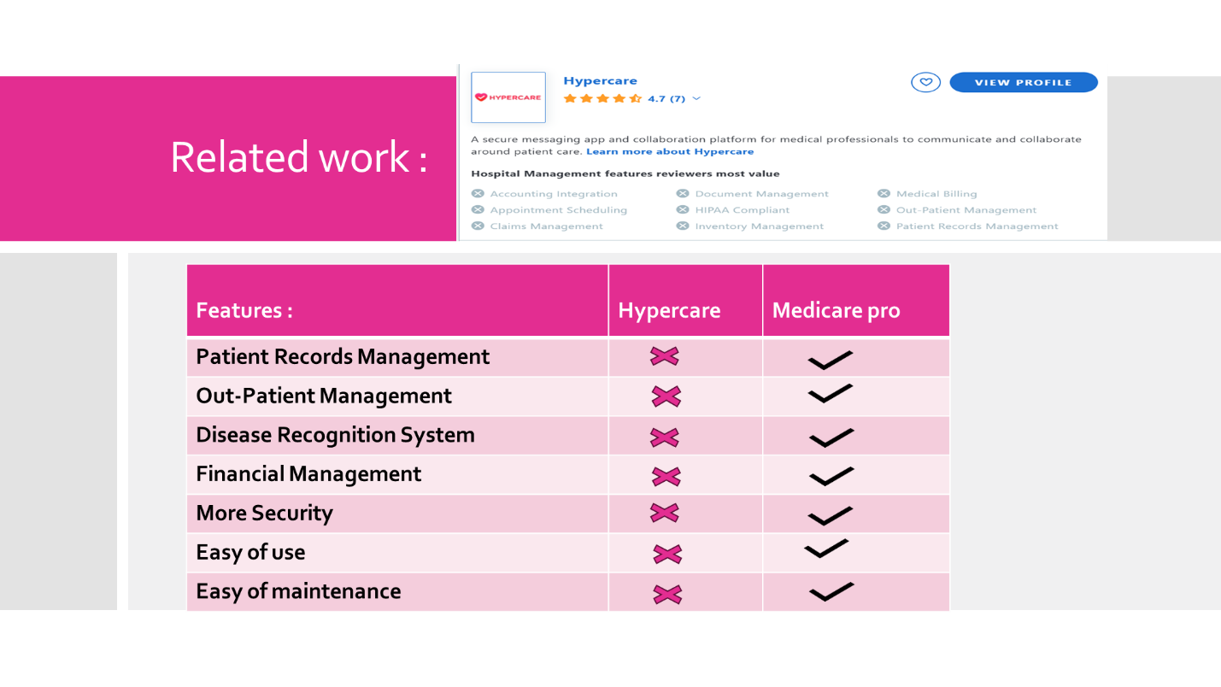
Screenshots :

Slide 12
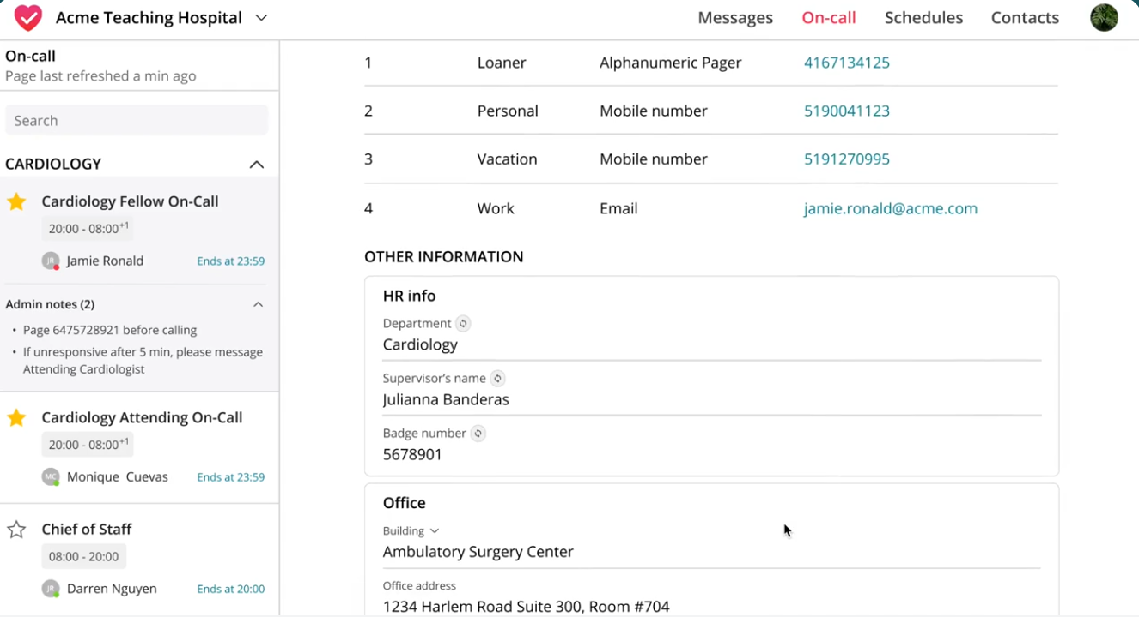
Screenshots :

Slide 13
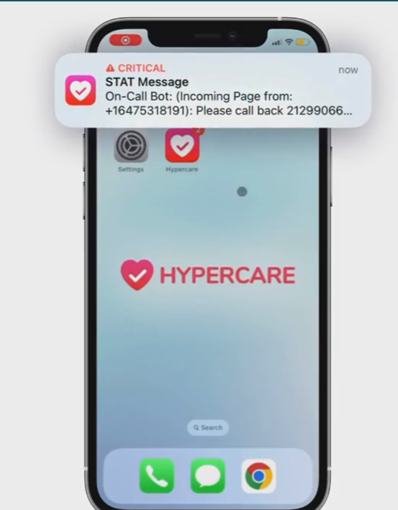
Screenshots :

Slide 14
System Requirements Engineering & planning
`

Slide 15


OUR Technology
Deep Learning
Frontend
Backend
Python
Asp.net webform
Asp.net & c# & SQL server
With Flask

Slide 16
System design 1-Frontend : ASP.net web forms
`

Slide 17
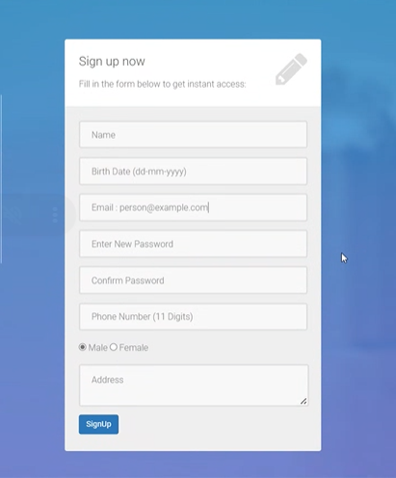
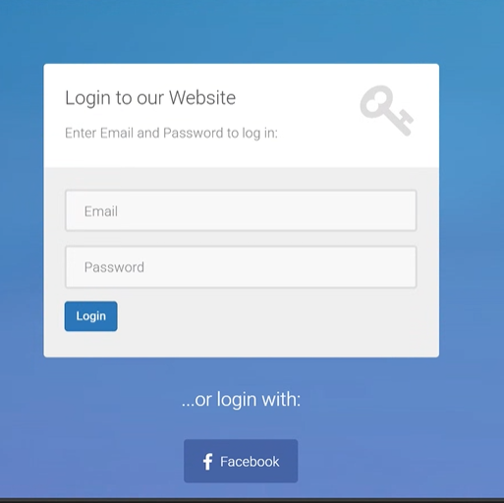
Frontend (Sign up & Login as Patient)
Signup Section :
New patients can register by filling in their personal details including name, date of birth, email, password, phone number, gender, and address.
The form ensures all required information is collected for account creation and future communication with the clinic.
Login Section :
This section allows existing patients to log in using their registered email and password.
Patients can also log in quickly using their Facebook account.
Also admin and doctors need to login with their existing accounts

Slide 18
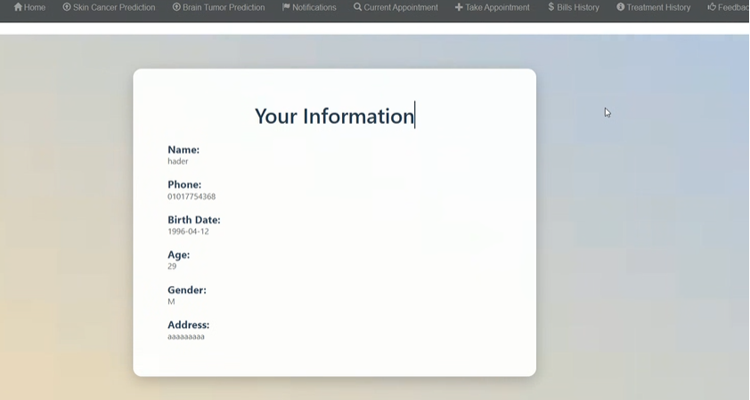
Frontend (Login Patient)
Patient Information Page
This page displays the patient's personal information including name, phone number, birth date, age, gender, and address.
Patients can review their registered details to ensure accuracy and keep their profile up-to-date.

Slide 19
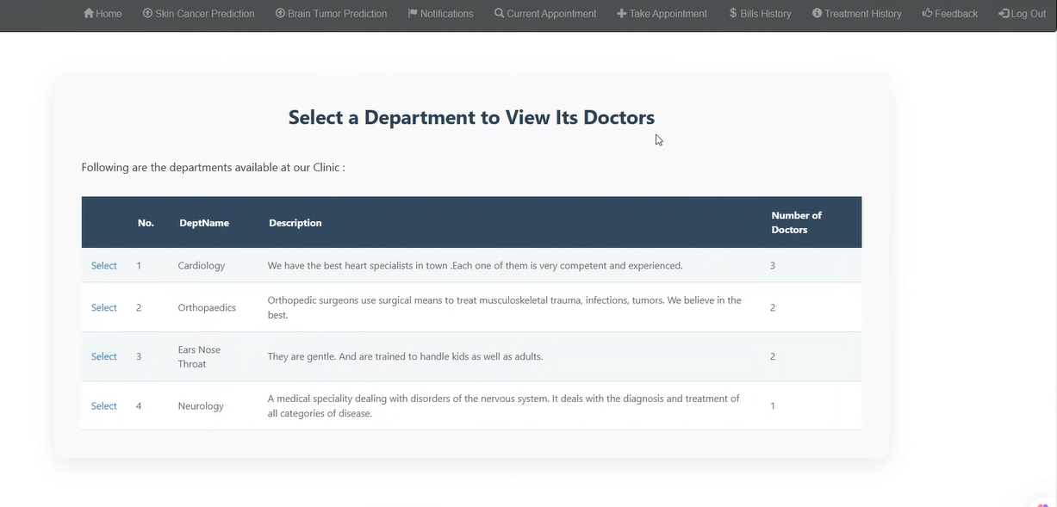
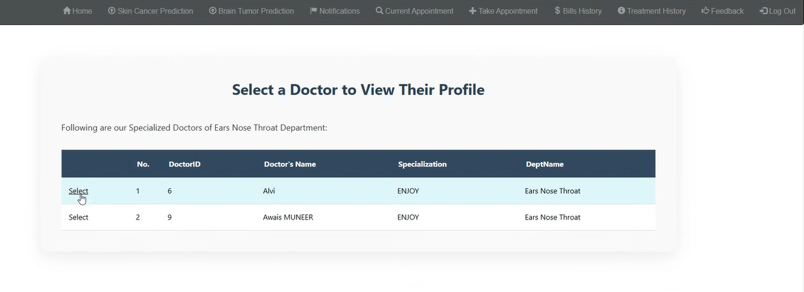
Frontend (Patient functions)
Select a Department Page
This page allows you to choose a medical department (e.g., Cardiology, Orthopaedics) to view available doctors.
I can click 'Select' next to any department to see its doctors and book an appointment.
Select a Doctor Page
This page shows the doctors available in the selected department. you can see each doctor’s name, ID, and specialization.
By clicking ‘Select’ I can view their profile and proceed to book an appointment.

Slide 20
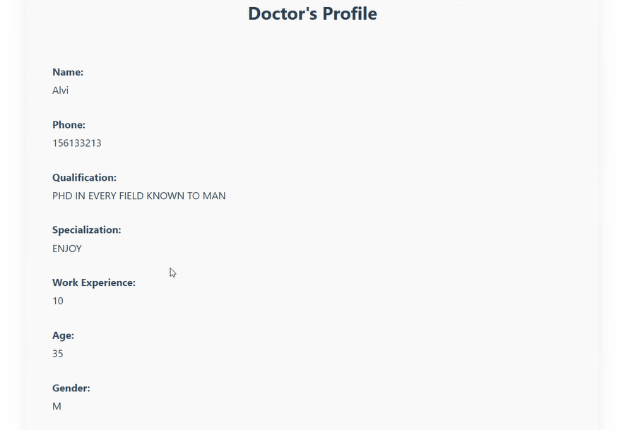
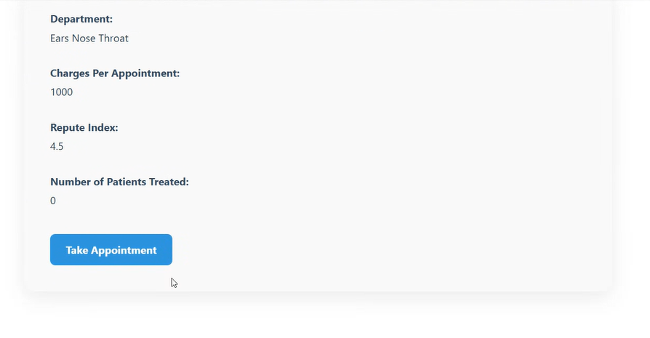
Frontend (Patient functions)
This page shows all the important information about the selected doctor. Like:
Name, phone number, qualifications, and specialization , Work experience, age, gender, Department they belong to, Appointment charges, Their reputation score (Repute Index) and
Number of patients they’ve treated
If you want to take appointment with this doctor, you can click the 'Take Appointment' button to book a consultation with the doctor.

Slide 21
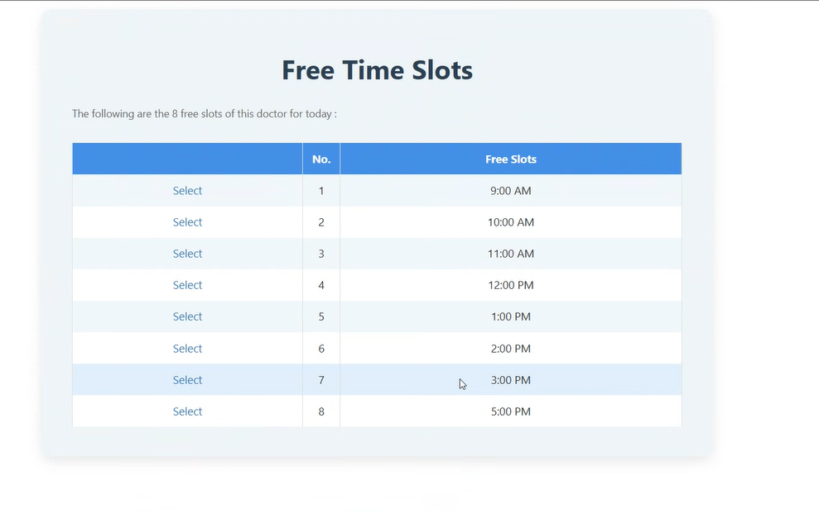
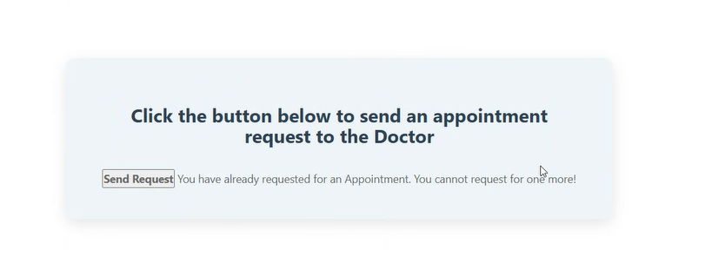
Frontend (Patient functions)
Free Time Slots Page
This page shows the doctor’s available time slots for today. you can choose a suitable time by clicking ‘Select’ next to the preferred slot (e.g., 10:00 AM or 3:00 PM) to book your appointment.”
Send Appointment Request Page
You can send request to the doctor in this page.
If you’ve already requested an appointment, you can’t send another one. The system shows a message preventing duplicate requests.

Slide 22
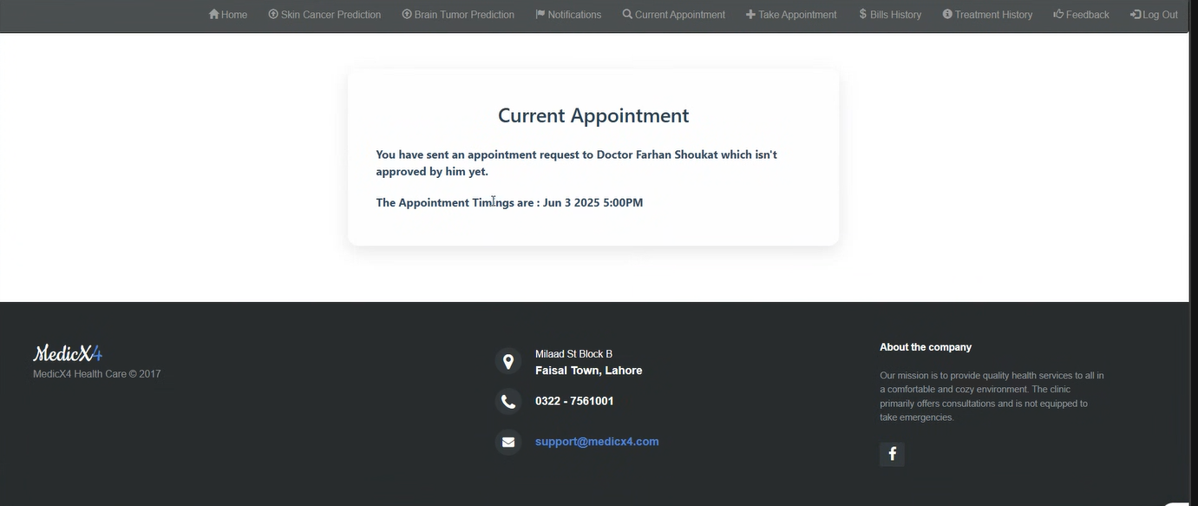
Frontend (Patient functions)
Current Appointment Page
You can choose a doctor’s appointment in this page
Example: "You have sent an appointment request to Doctor Farhan Shoukat which hasn't been approved by him yet."

Slide 23
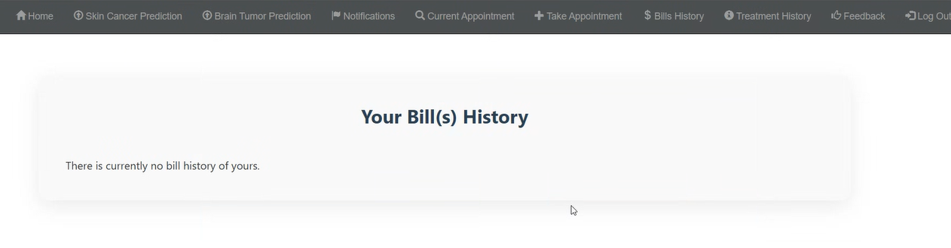
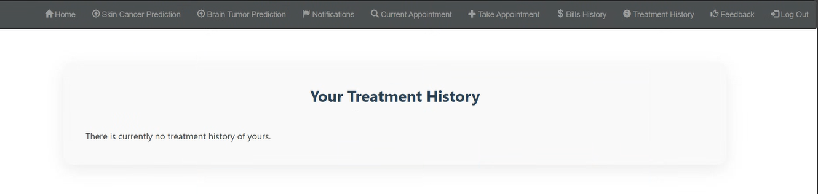
Frontend (Patient Functions)
Bill(s) History Page
This page shows the patient's billing history.
If there are no billing records available, a message indicating the absence of bills is displayed.
Treatment History Page
This page displays the treatment
history of the patient.
If no treatments have been recorded, a message is shown indicating that there is currently no treatment history.

Slide 24
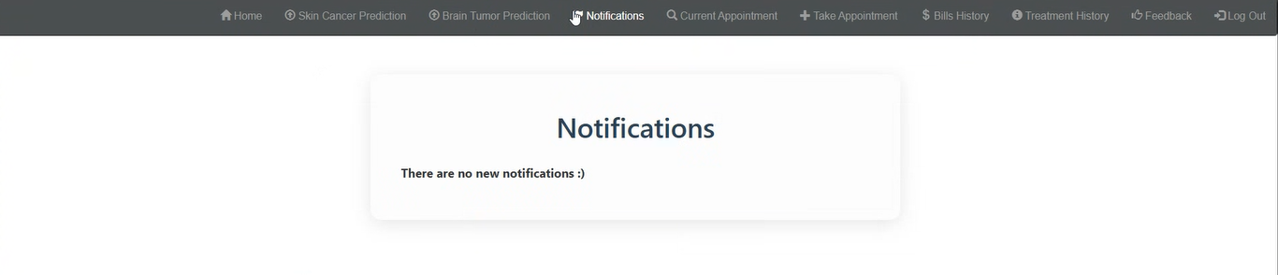
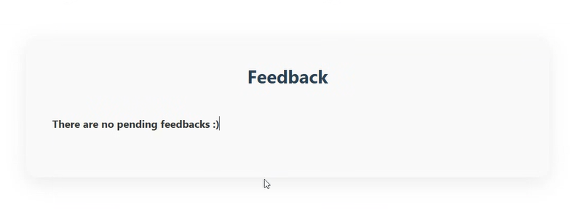
Frontend (Patient Functions)
Notifications Page
This page displays any important notifications for the patient.
If there are no new notifications, a message is shown to inform the user.
Feedback Page
This page shows the feedback status from the patient.

Slide 25
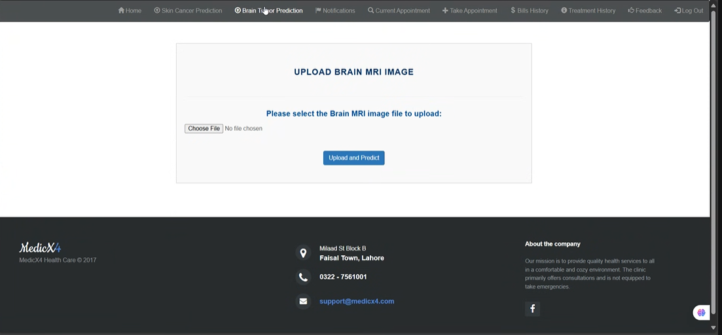
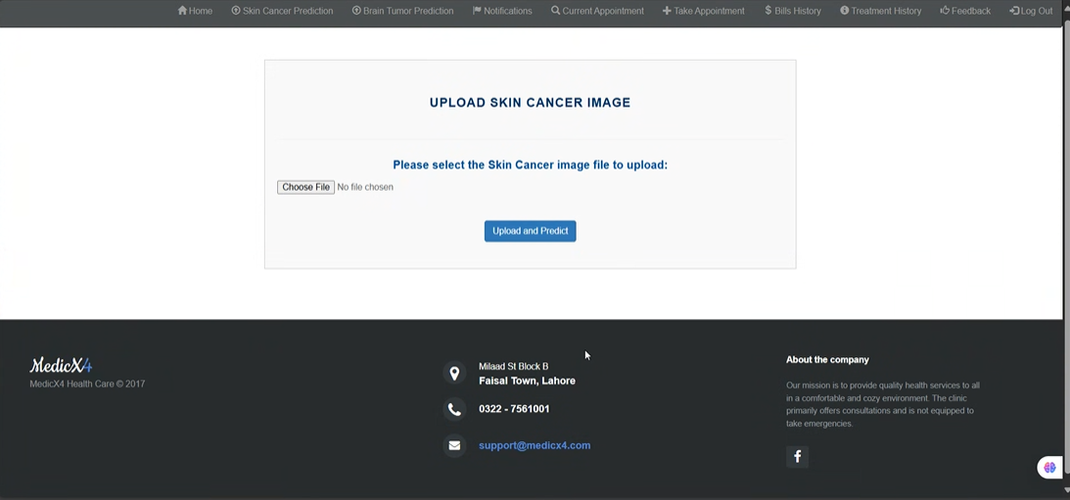
Frontend (Predict MRI)
Brain MRI Image Upload Page
Patients can upload a brain MRI image to check for possible brain tumors using AI prediction.
"Click 'Choose File' to select your MRI scan, then click 'Upload and Predict' to get results."
Skin Cancer Image Upload Page
This page allows patients to upload an image of a suspected skin cancer lesion.
" After selecting the image file, patients can click 'Upload and Predict' to receive an AI-based prediction."

Slide 26
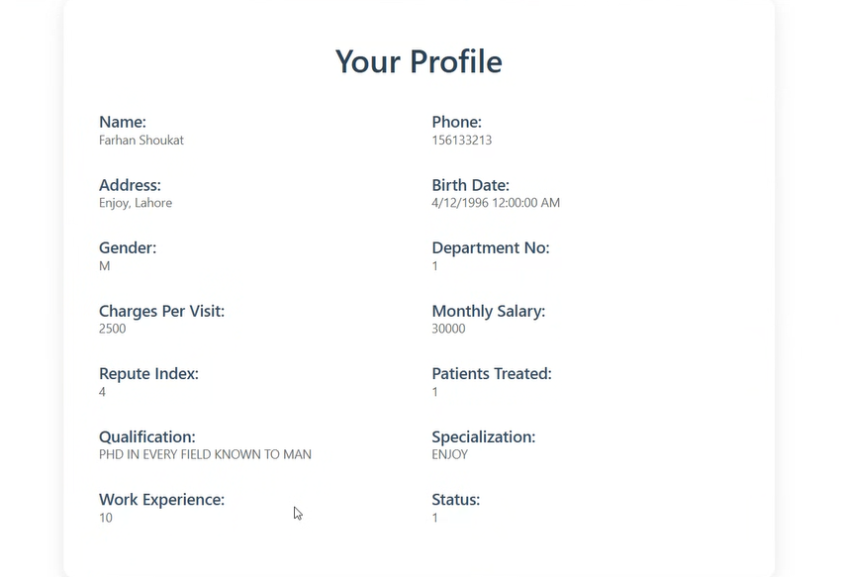
Frontend (Login as doctor)
Doctor’s Personal Profile Page
Displays your detailed professional and personal information as a doctor including:
Name, Phone, Address, Birth Date
Gender, Department No., Charges, Salary
Experience, Reputation Index, Qualification
Specialization, Patients Treated, Status

Slide 27
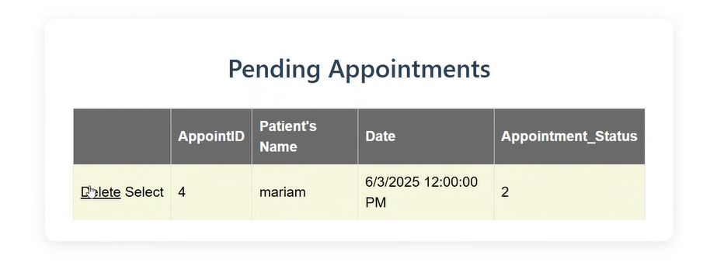
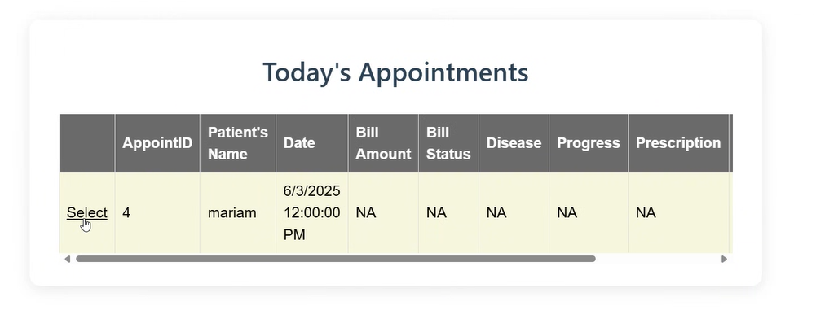
Frontend (Doctor Functions)
Pending Appointments
This page displays a list of all
pending appointments for the doctor.
Doctors can either select or delete an appointment using the available actions.
Today's Appointments Page
This page displays all of the doctor’s scheduled appointments for the current day.
The "Select" option allows the doctor to view or update the patient's medical history and billing details like shown in the next page.

Slide 28
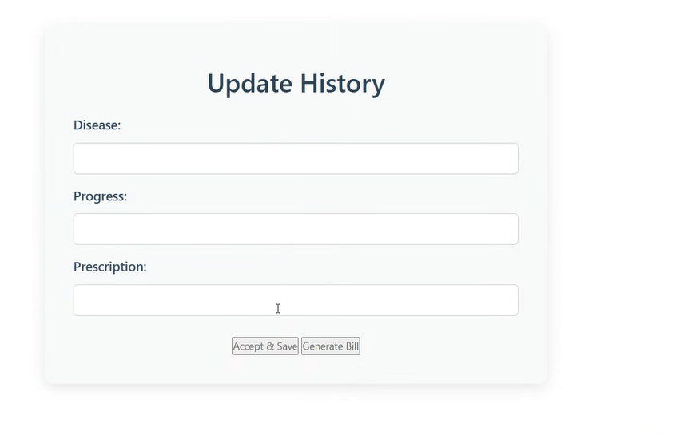
Frontend (Doctor Functions)
Update History
This page allows doctors to update a patient's medical record after a consultation.
It includes fields for the disease diagnosis, treatment progress, and prescription details. Doctors can either save the updated information or generate a bill using the respective buttons. The design is clean and focused on quick data entry.

Slide 29
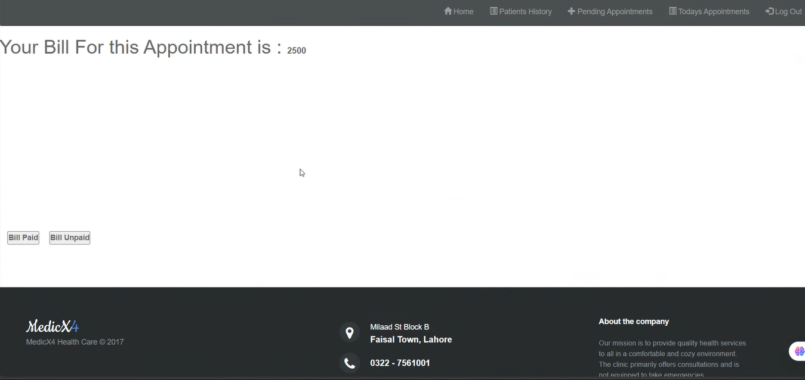
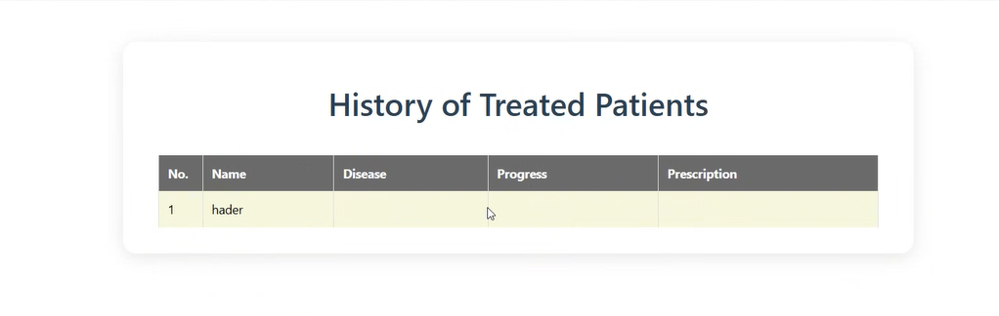
Frontend (Doctor Functions)
Billing Page
This page displays the total bill amount for a patient's appointment.
There are two buttons:
Bill Paid – Marks the bill as paid.
Bill Unpaid – Keeps the bill as unpaid.
The page ensures that the payment status is clearly tracked and updated.
History of Treated Patients
This page shows a record of all patients who have been treated.

Slide 30
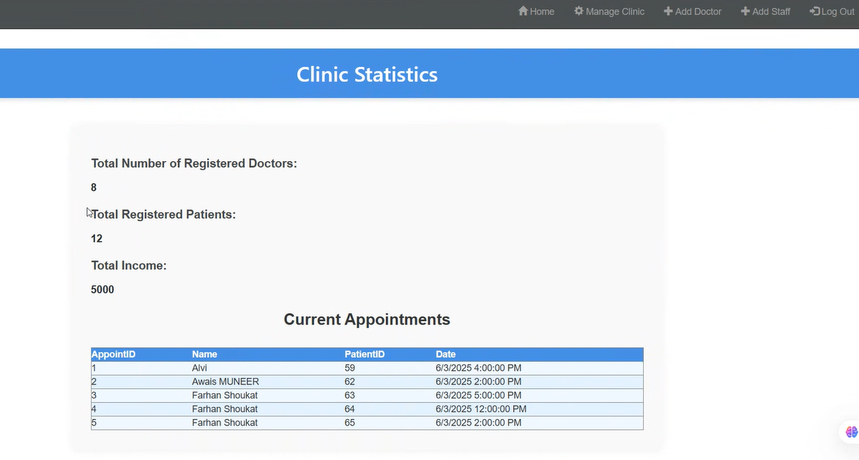
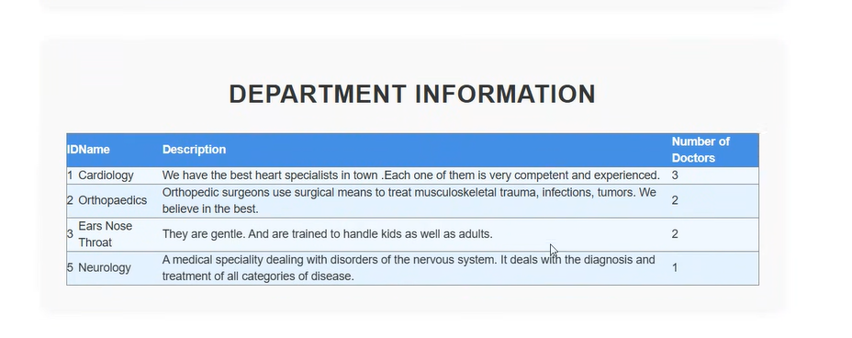
Frontend (Admin home page)
Clinic Statistics
This page helps administrators monitor clinic activity at a glance.
It provides a summary of key clinic data: Like Total Registered Doctors: 8
Total Registered Patients: 12
Total Income: 5000
It also shows a table of Current Appointments with: Appointment ID ,Patient Name, Patient ID, Date & Time.
Department Information Page
This page displays information about the medical departments available in the clinic or hospital

Slide 31
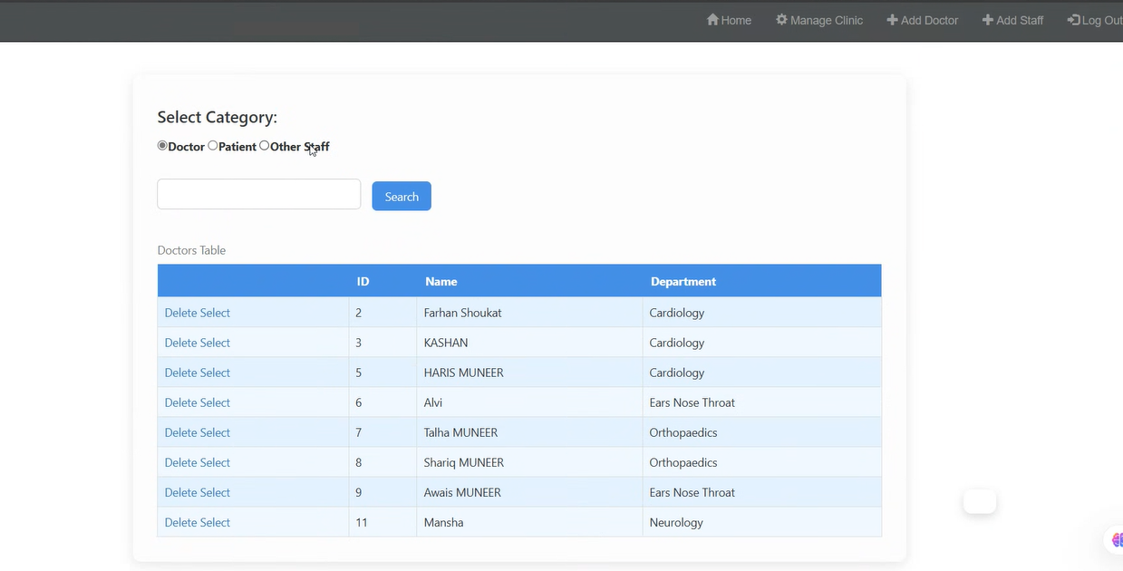
Frontend (Admin functions)
Doctors & Staff Management Page
This page allows clinic administrators to view, search, select, and delete staff records based on their category.
you can choose the type of staff to display: Doctor , Patient and Other Staff Once a category is selected, the relevant data appears in the table below. Here
The Doctor Category section displays a list of all registered doctors in the clinic. Each entry provides options to: Select the doctor (for viewing or editing details). Delete the doctor from the system.
This section helps clinic administrators manage doctor records efficiently searching, filtering, or removing entries as needed.

Slide 32
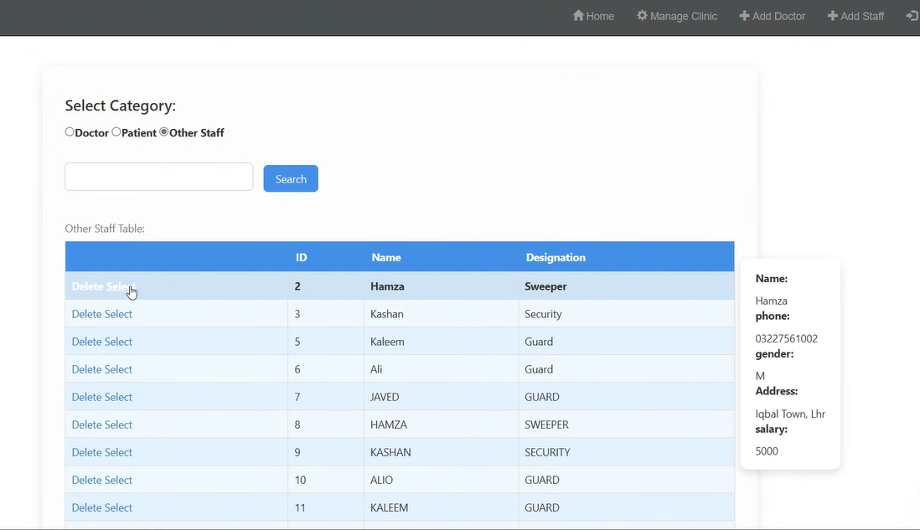
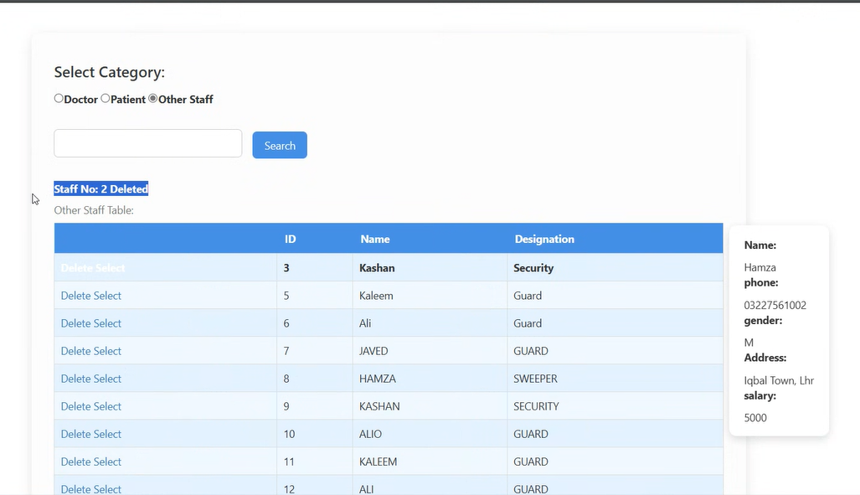
Frontend (Admin functions)
Other Staff Category
This section displays and manages non-medical staff members in the clinic.
Each row has options to:
Select a staff member to view additional details in a sidebar, including : Phone number, Gender, Address, Salary.
Delete the staff record.
This section allows clinic administrators to manage support staff efficiently and maintain their profiles.

Slide 33
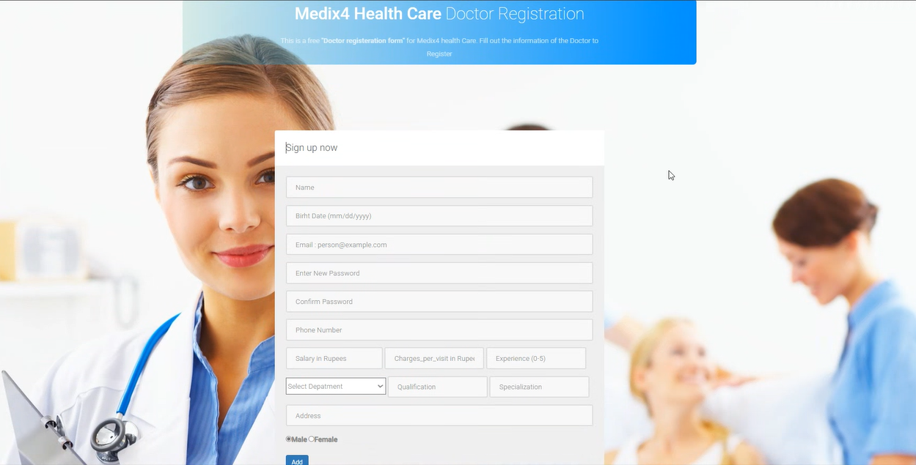
Frontend (Admin functions)
Doctor Registration Page
This form allows admins to assign doctors by create a profile and become a part of the our Health Care system.
It's designed to collect detailed information from doctors who want to register with the clinic.
Once registered, their information can be used for scheduling, clinic management, and patient appointments.

Slide 34
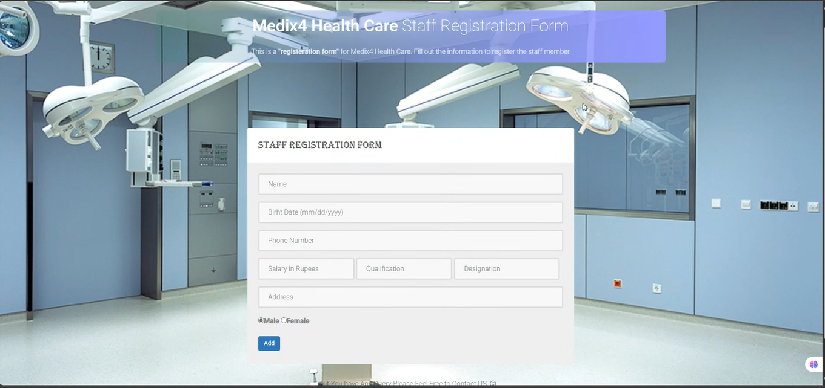
Frontend (Admin functions)
Staff Registration Form page
This is a registration form for our Health Care System. Admin Fill out the information to register the staff member.
It is used for non-doctor staff members such as guards, sweepers, receptionists, or technical personnel.
It helps keeping of all support staff, allowing the hospital or clinic to manage salaries, roles, and contact information effectively.

Slide 35
System design 2-Backend
`

Slide 36
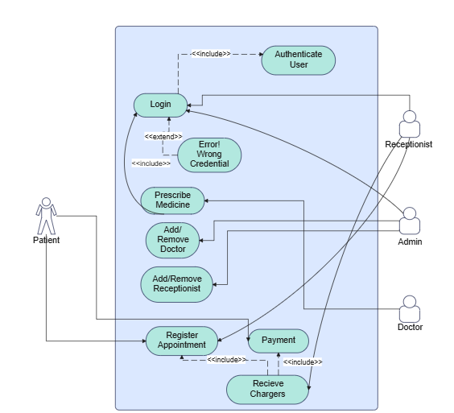
Backend UML Use Case

Slide 37
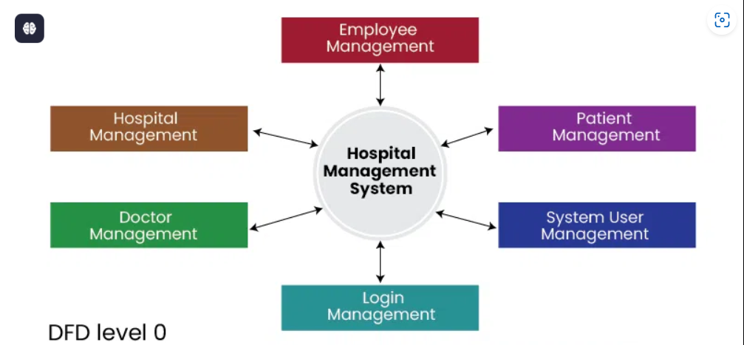
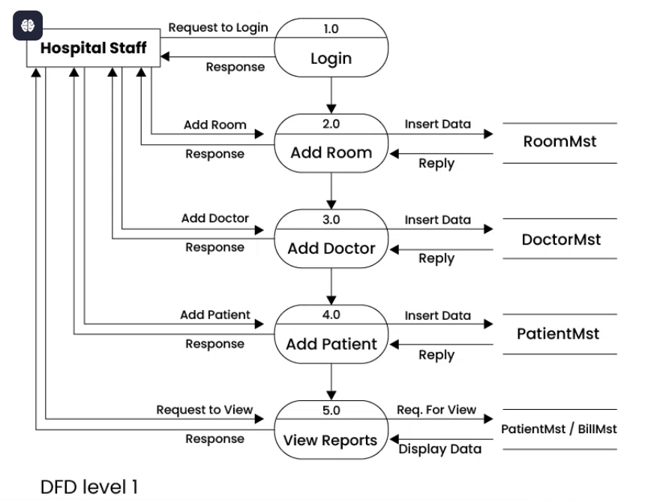
Backend Data Flow Diagram

Slide 38
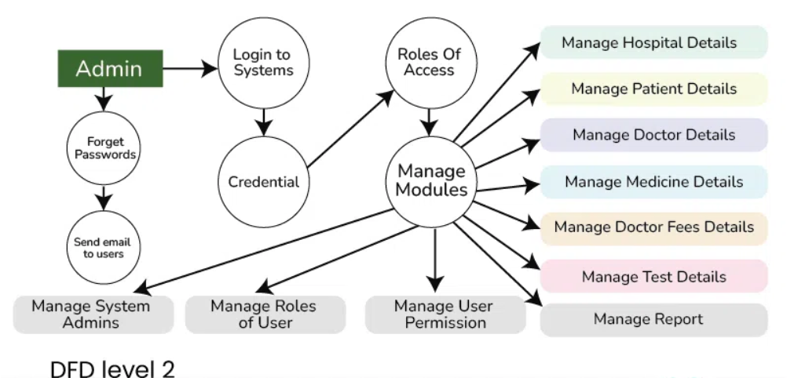
Backend Follow Data Flow Diagram

Slide 39
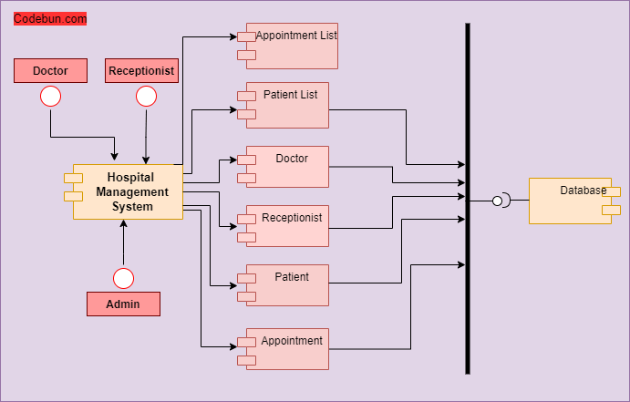
Backend UML Activity Diagram

Slide 40
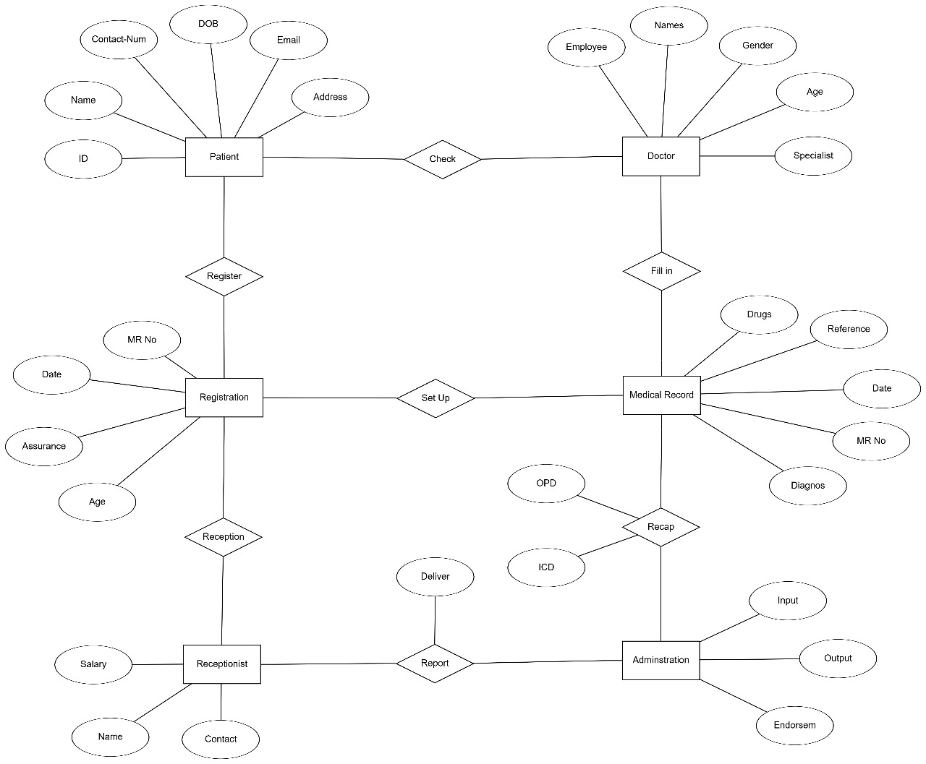
Backend ERD

Slide 41
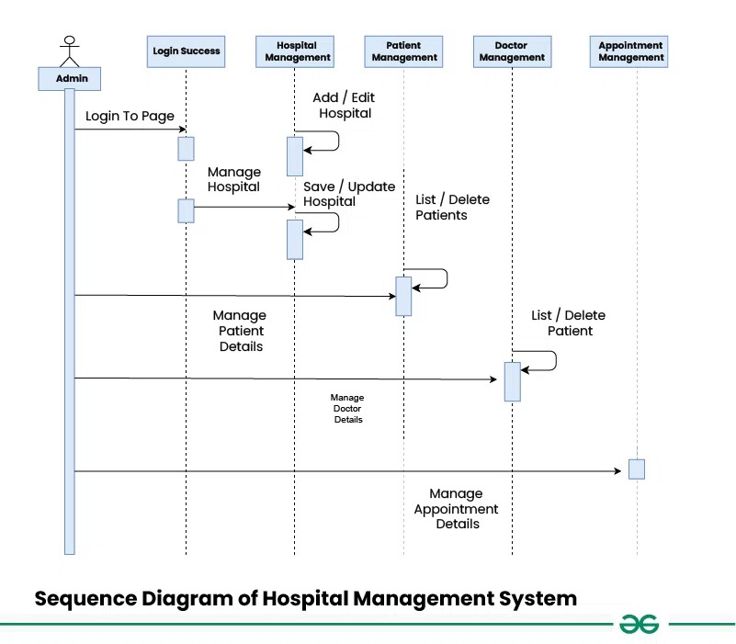
Backend UML Sequence Diagram

Slide 42
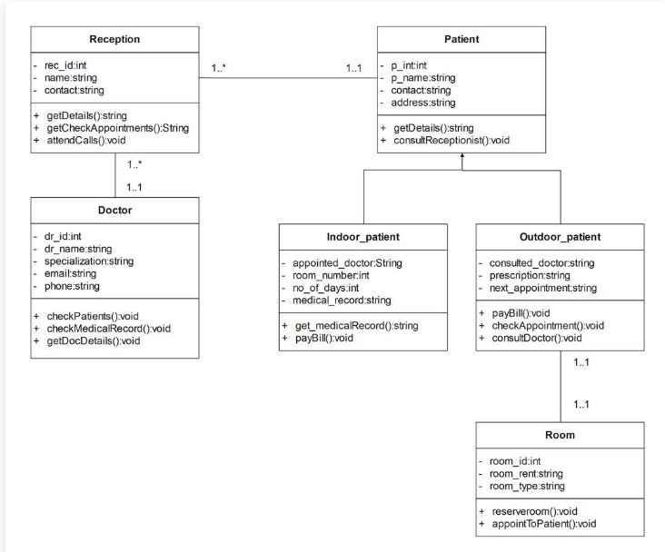
Backend UML Class Diagram

Slide 43
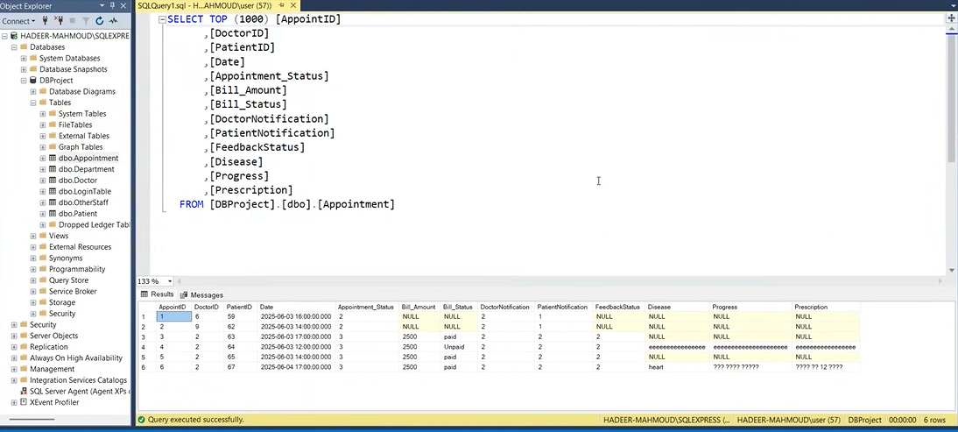
Backend (SQL Tables)
Appointment table

Slide 44
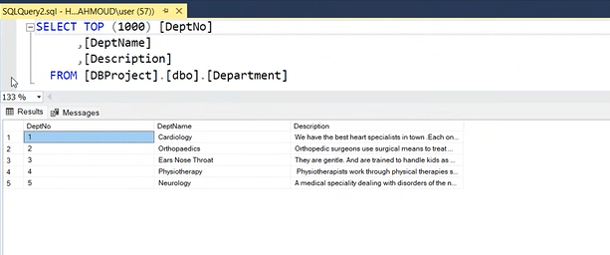
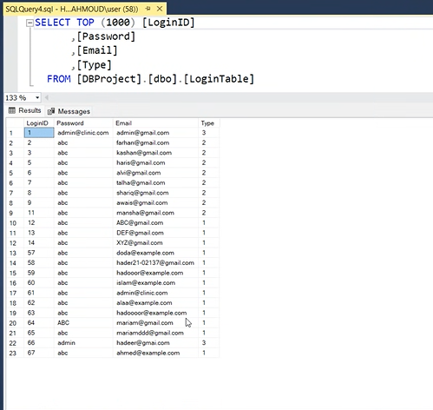
Backend (SQL Tables)
Department table
Login table

Slide 45
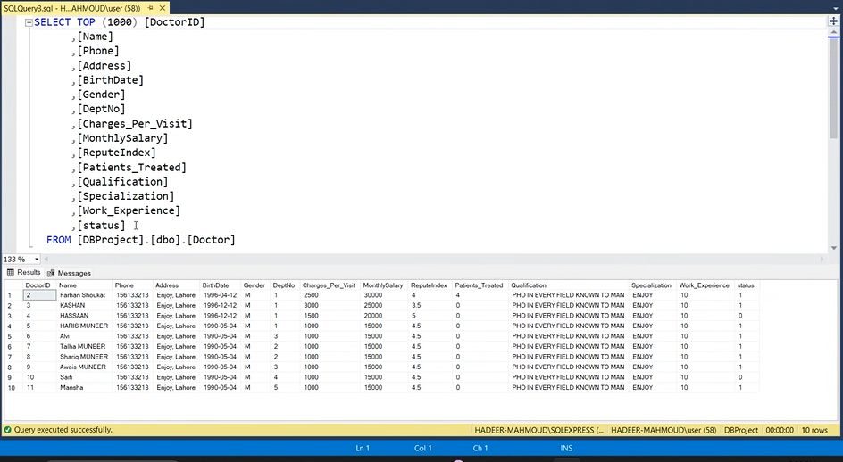
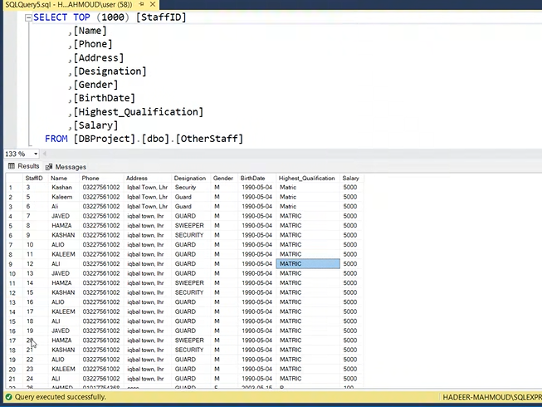
Backend (SQL Tables)
Doctor table
Staff table

Slide 46
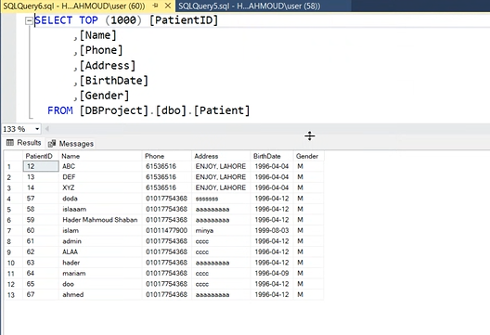
Backend (SQL Tables)
Patient table
This table stores patient information including name, contact details, address, date of birth, and gender
which helps in identifying and managing patient records throughout the hospital system.

Slide 47
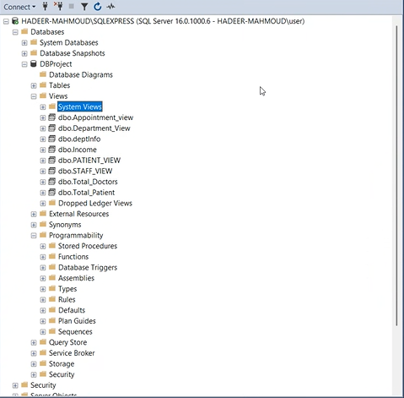
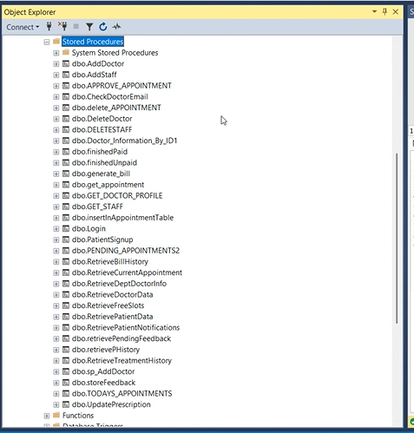
Backend (Stored procedures)

Slide 48
System design 3- Deep Learning
`

Slide 49
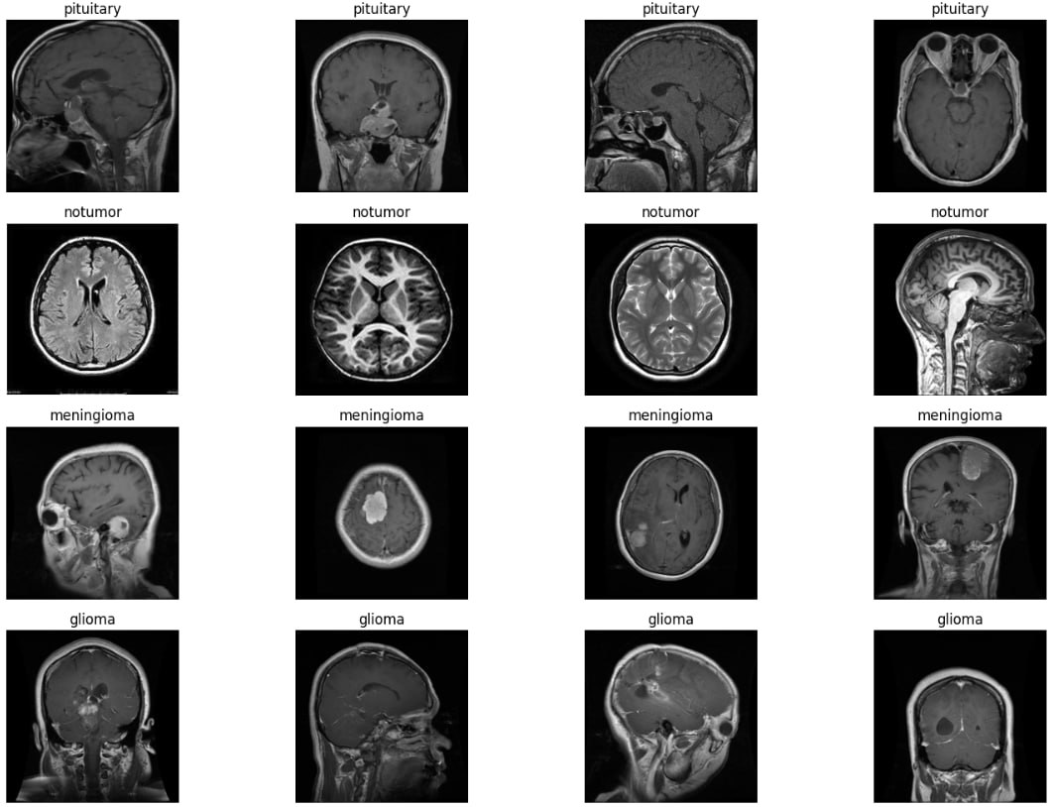
Deep Learning (Brain tumor dataset)
Screenshots Of Datasets :
MRI brain scans used in our classification model.
To train our brain tumor classification model, we used a labeled MRI dataset
containing four classes:
Pituitary
No Tumor
Meningioma
Glioma
The data is relatively balanced across all classes, which helps the model learn effectively and avoid bias toward any specific category.

Slide 50


Deep Learning (Dataset Distribution)
Training Set (5,712 images)
Glioma: 1,321
Meningioma: 1,339
Pituitary Tumor: 1,457
No Tumor: 1,595
Testing Set (1,311 images)
Glioma: 300
Meningioma: 306
Pituitary Tumor: 300
No Tumor: 405

Slide 51

Data Augmentation and Accuracy Results
Training: Images are resized, randomly flipped, shifted, rotated, brightened, then normalized and converted to tensors. These augmentations help the model generalize better.
Testing: Images are resized, normalized, and converted to tensors without augmentation to ensure consistent evaluation.
The model achieved excellent performance with a training accuracy of 98.34%,
validation accuracy of 97.99%,
and test accuracy of 98.02%,
indicating strong generalization and reliability in predicting brain tumors.

Slide 52


Deep Learning(Brain tumor)
Step 2: Select Brain MRI Image from Device
Step 1: Upload Brain MRI Image

Slide 53

Deep Learning(Brain tumor)
Step 3: Prediction Result Displayed

Slide 54
Key Goals
Early Detection: Identify tumors in the early stages to increase treatment success.
High Accuracy: Minimize false positives and false negatives to ensure reliable diagnosis.
Automated Analysis: Reduce the dependency on manual interpretation, making the process faster and more efficient.
Classification: Differentiate between tumor types
upport for Medical Experts: Assist radiologists and doctors in decision-making by providing AI-driven insights.

Slide 55


Deep Learning ) Skin cancer (
As part of our Hospital Management System, these medical images are utilized by a deep learning model trained to classify and predict skin cancer types such as:
Melanocytic Nevi
Melanoma
Benign Keratosis
Basal Cell Carcinoma
Actinic Keratoses
Vascular Lesions
Dermatofibroma
Screenshots Of Datasets :

Slide 56

Deep Learning) Skin cancer (
Data Processing
The skin lesion images were read using OpenCV, resized to a fixed size, converted to grayscale, and then displayed as sample images using subplot for visualization.
After resizing, normalization was applied by dividing by 255 to bring all pixel values to the same scale (0 to 1), ensuring the model doesn't favor one class over another due to varying pixel intensity ranges.

Slide 57


Deep Learning) Skin cancer (
The base model achieved 82%. To improve this, we trained a simple model using its predictions combined with the original data.
This added new features and improved results, with Logistic Regression reaching 84% and Random Forest 83.1%.

Slide 58


Deep Learning(Skin Cancer)
Step 2: Select skin Image from Device
Step 1: Upload Skin cancer Image

Slide 59

Deep Learning(Brain tumor)
Step 3: Prediction Result Displayed

Slide 60
Key Goals
Build a strong image classifier: Using Xception model to handle large data and reduce overfitting.
Improve accuracy and performance: Fine-tuned the whole model and added layers to help the model learn better.
Avoid wasting time and resources:
Used EarlyStopping to stop training when it’s no longer improving.
Used ReduceLROnPlateau to slow down learning rate if the model gets stuck.
Handle unbalanced classes: Tried to make the model work well across all classes, not just the big ones.
Save and reuse the model: Saved the model structure and weights so it can be used again without retraining.
Check how good the model is: Used accuracy and classification report to evaluate how well the model performs on test data.

Slide 61
Thank you

